Slide 1

Global Economic and Demographic Trends Analysis: Business Requirement Document (BRD)
By
Jayanthar S
DADS
July Cohort – B

Slide 2
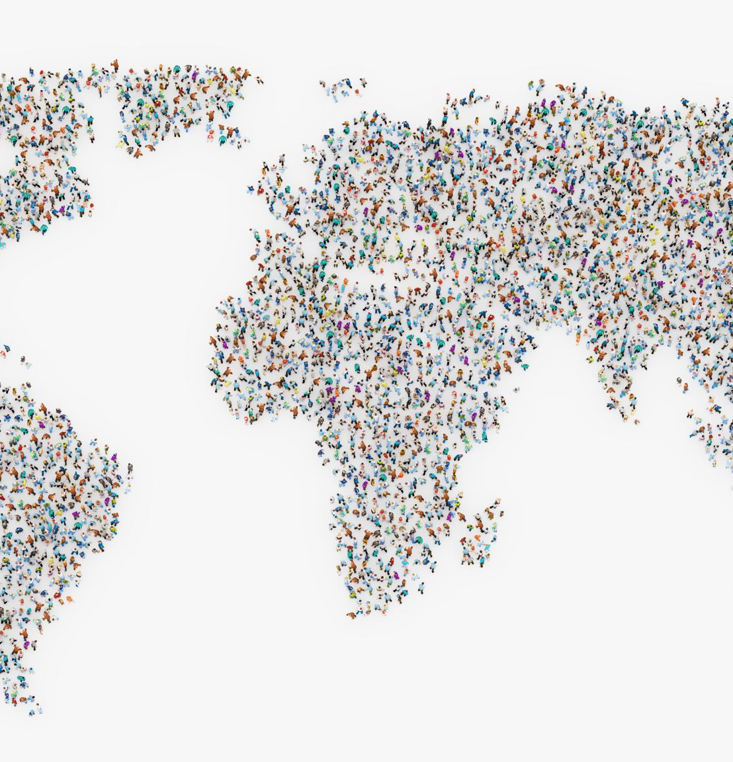
Project Overview
Deals with country wise population, infant mortality, GDP per capita, birth rate, death rate, GDP, income group among different countries
Shows how the population trend goes over the years and GDP per capita of countries varies over the years
Population density by region to identify the which region has the higher and lower population density among the others

Slide 3
Project Description
Cleaned the dataset to make the dataset proper and structed
Performed the DAX function to create calculated measures
Created charts to place the values for better understanding
Included slicers and cards to show the important values and modify the charts according to the condition given

Slide 4
Cleaning Process
Cleaned the dataset in power query editor
Combined the three into one dataset with append queries
Unpivoted some of the columns and renamed the columns
Checked the datatype of the columns
Removed null, empty spaces, unwanted columns, rows and duplicates

Slide 5
Files Connectivity
MySQL server database connection for countries world dataset
Excel workbook connection for GDP by country 1960 – 2016 dataset
CSV connection for meta data country and population per country dataset

Slide 6

DAX Functions
Identified max and min population, infant mortality and GDP using max and min function
Calculated total GDP and population of the country using sum function
Used average function to identify the average population, infant mortality and GDP per country

Slide 7
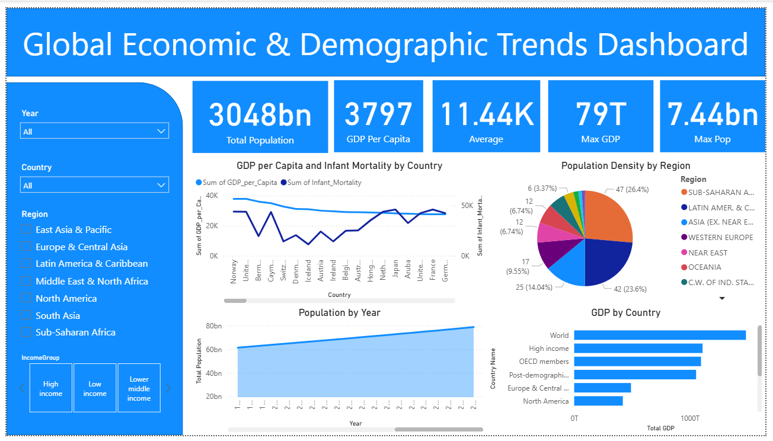
Dashboard

Slide 8
Dashboard Overview
In GDP by country world shares the higher GDP and low income category people shares lower GDP
Population by year shows upper trend from the years of 1960 to 2016
Population Density by region we have higher shares from sub Saharan African, Latin, Amer & Carib & Asia regions
GDP per capita & Literacy rates are high in Norway and lower in Somalia

Slide 9
Key Insights
United Status shares the higher GDP per capita of 37800 and Sierra Leone shares the lower GDP per capita of 500
Asia (ex near east) shares the higher and lower population density
China, India and America shares the highest population growth rates among the Asia and North American regions
Infant mortality shows downward trends in the current times among the different countries

Slide 10
Conclusion
Identified which countries shares the higher and lower percent of GDP, population density among the world
Over the years how the population trends moves in upward or downward
In GDP which income group shares the most and least contribution among the region’s countries
Birth rates, infant mortality and death rates how it impacts and affects the population and population density over the years

